Slide 1

REPLACEMENT
CARD
ohamvets.org
AMVETS DEPARTMENT OF OHIO

Slide 2
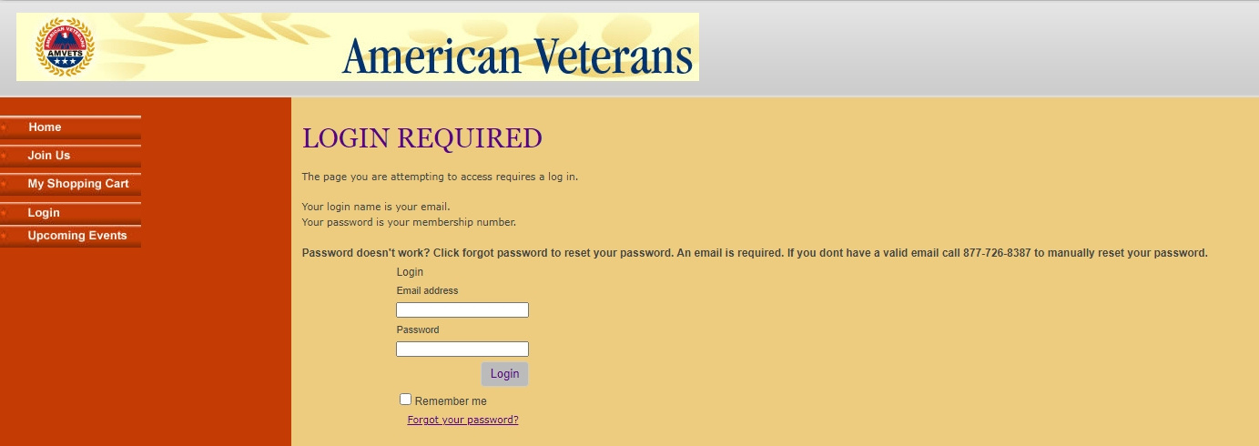
AMVETS Dept. of Ohio
Membership Login
Member MUST have an email in the system for this to work
MEMBERSHIP LOG IN is first step – use email address and member number of the member the card is for

Slide 3
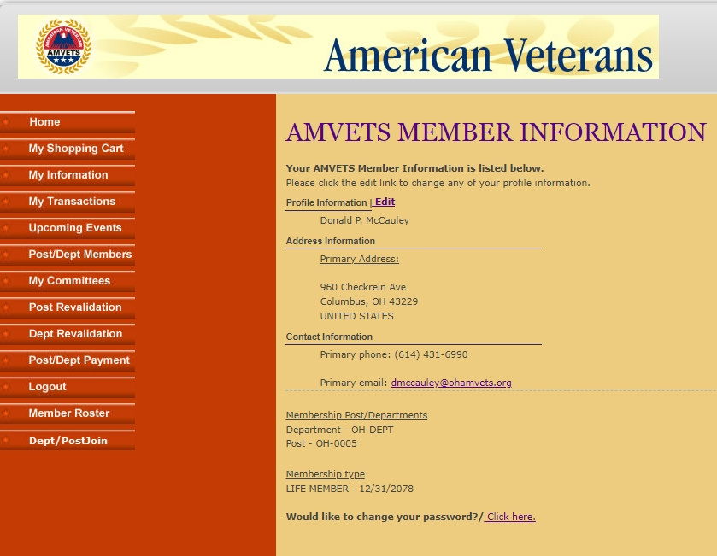

AMVETS Dept. of Ohio
Step 1
Click on MY SHOPPING CART

Slide 4
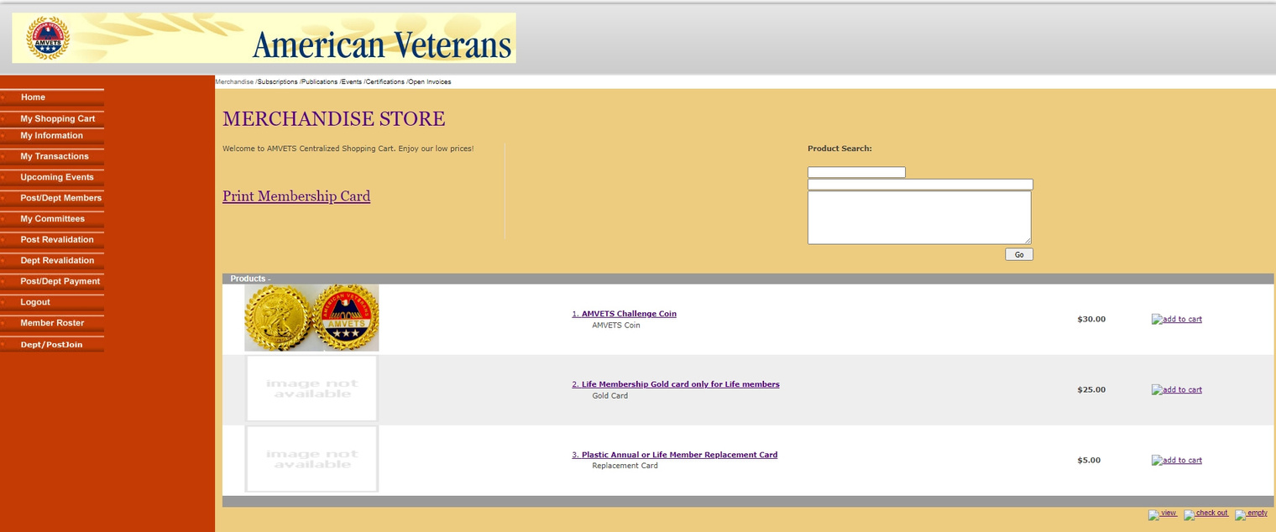
AMVETS Dept. of Ohio
Step 2
NEW CARD STEP 2 – click PRINT MEMBERSHIP CARD print the card for $0
Click ADD TO CART for Plastic Annual or Life Replacement card for $5
Click ADD TO CART for Life Membership Gold Card for $25

Slide 5
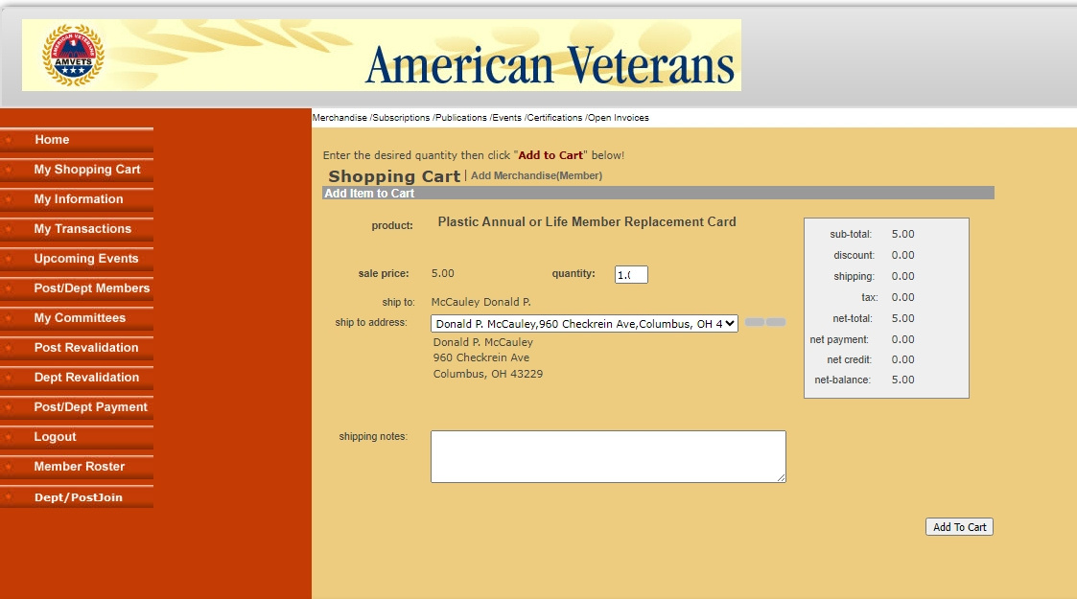
AMVETS Dept. of Ohio
Step 3
Make sure address and amount are correct then click ADD TO CART

Slide 6
AMVETS Dept. of Ohio
Step 4
click CHECK OUT

Slide 7
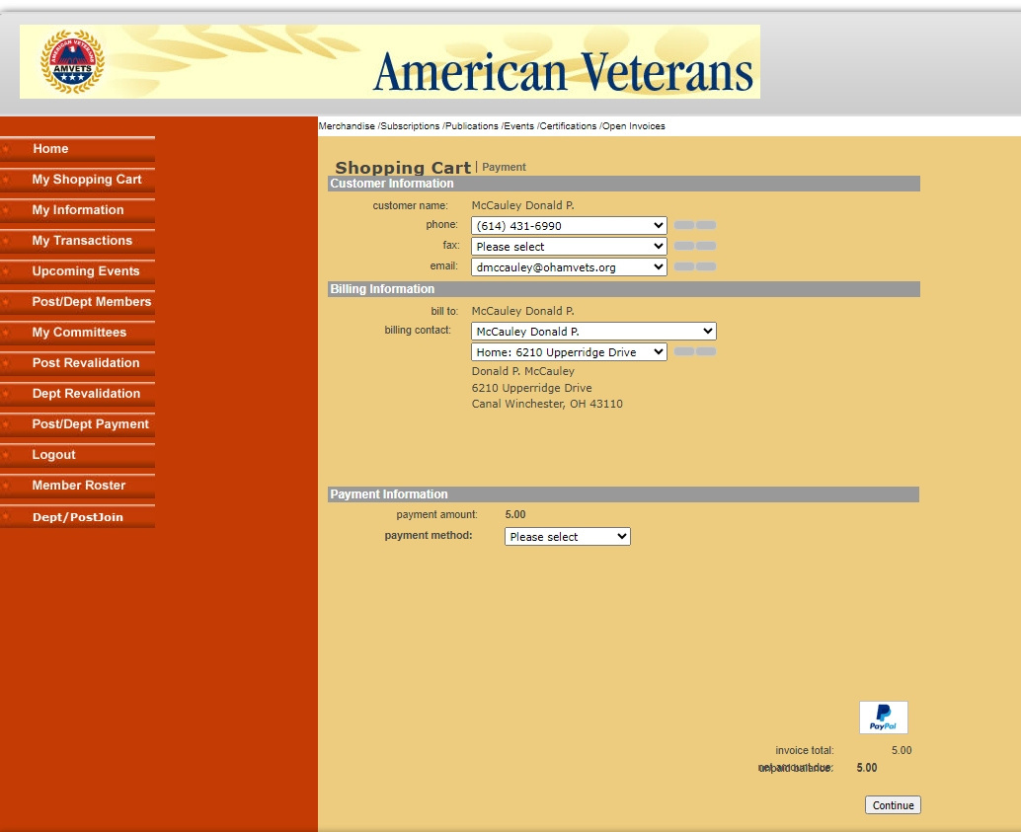
AMVETS Dept. of Ohio
Step 5
Click PAYMENT METHOD, fill out credit card information and click CONTINUE

