Slide 1


AMVETS DEPARTMENT OF OHIO
Updated August, 2024
Membership 101

Slide 2
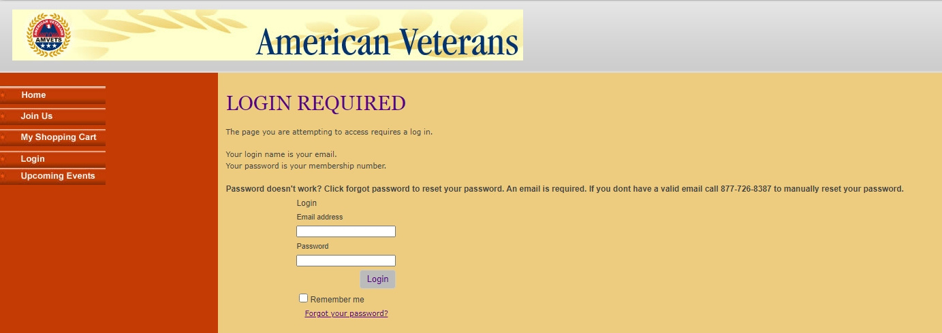
Login
  Use your email address and member number to log in.
  Ensure you have your membership number handy.

Slide 3
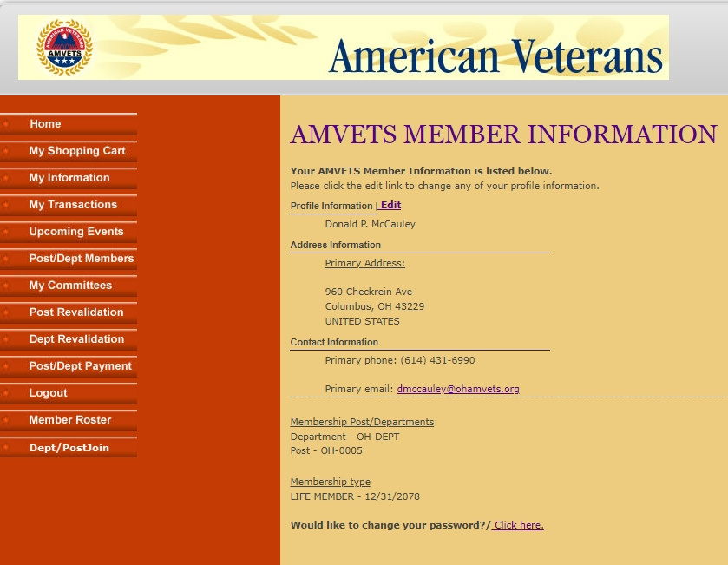
Join Dept/Post
  Click on "Dept/Post Join" to begin the membership process.

Slide 4
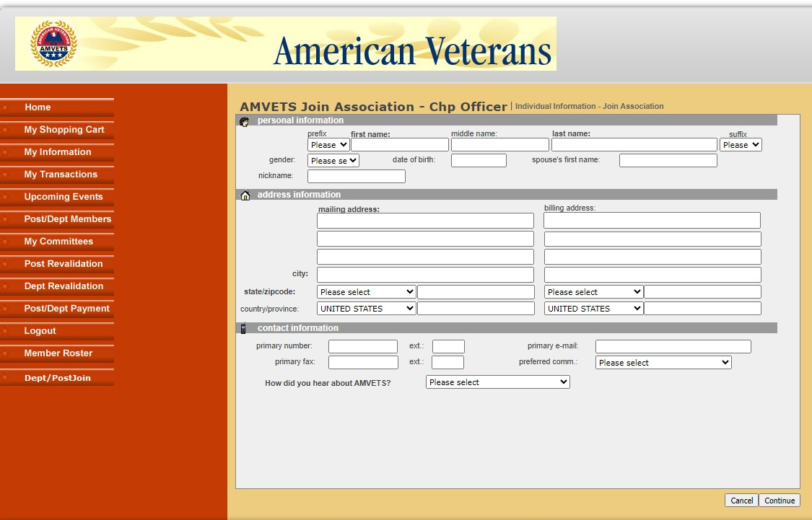
Fill in Info
  Fill out the following required fields:
  First Name
  Last Name
  Gender
  Date of Birth
  Mailing Address
  Primary Number
  Primary Email

Slide 5
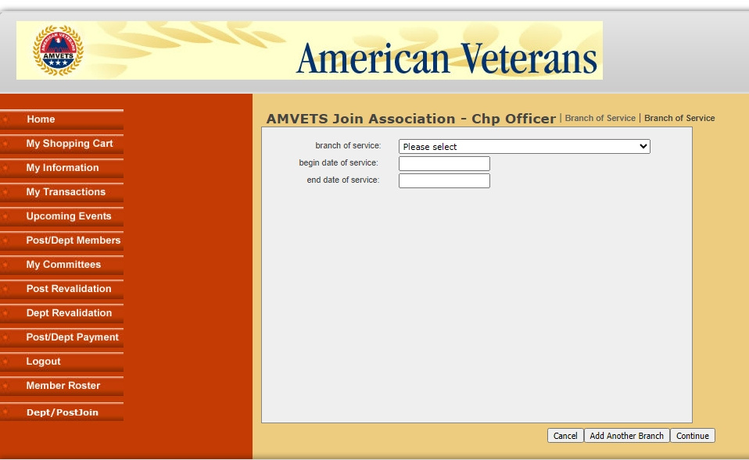
Service Info
  Enter your service information.
  Use the format mm/dd/yyyy for dates.
  Click "Continue" after entering the information.

Slide 6
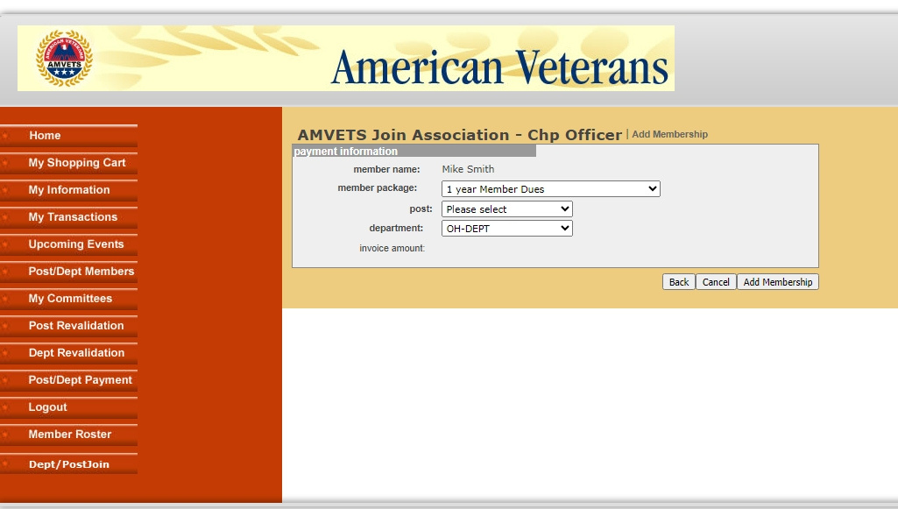
Package
  Select a membership package: Annual or Life by age.
  Click "Add Membership" to proceed.

Slide 7
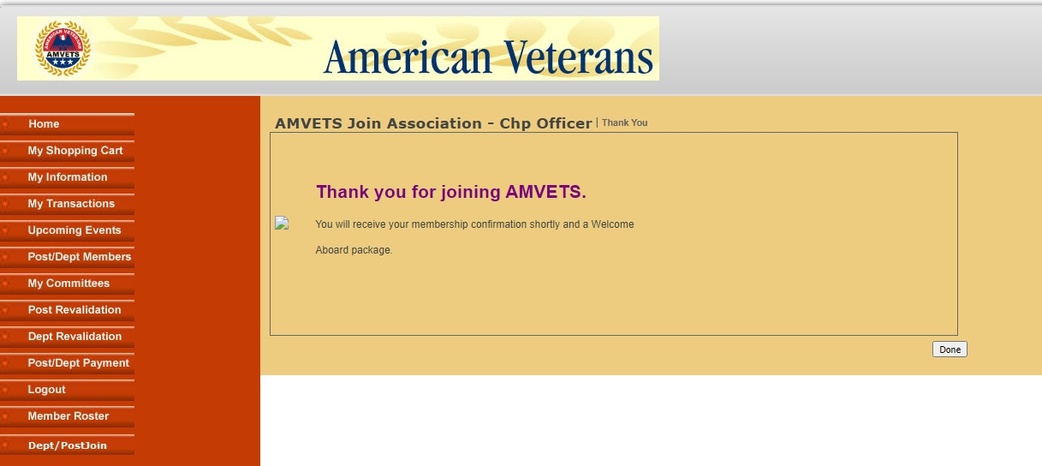
Complete
  Click "Done" to finalize your membership process.

